Slide 1

RUNGTA COLLEGE OF DENTAL SCIENCES AND RESEARCH
SMEAR LAYER
DEPARTMENT OF CONSERVATIVE DENTISTRY AND ENDODONTICS

Slide 2
Specific learning Objectives
At the end of this presentation the learner is expected to know ;
Core areas* | Domain ** | Category #
Introduction | Cognitive | Nice to know
Definitions | Cognitive | Must know
Bonding of smear layer | Cognitive | Must know
Morphology | Cognitive | Must know

Slide 3
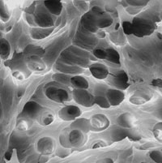
Contents
Definitions
history
Structure and components
Morphology
Bonding & smear layer
Method of removal
Conclusion
references

Slide 4
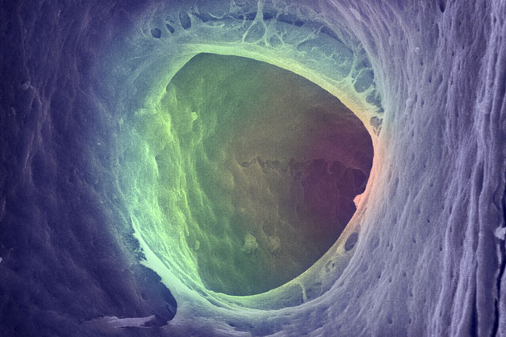
SHOULD THE SMEAR LAYER BE REMOVED???

Slide 5
Should be removed
Pashley 1985, Meryon & Brook 1990, Gutmann 1993, Drake et al. 1994, Goldberg et al. 1995, George et al. 2005, Shahravan et al. 2007
1. It has an unpredictable thickness and volume, because of greater portion of it consists of water it should remove.

Slide 6
2. It contains bacteria, their by-products and necrotic tissue. Bacteria may survive and multiply and can proliferate into the dentinal tubules, which may serve as a reservoir of microbial irritants.
3. It may acts as a substrate for bacteria, allowing their deeper penetration in the dentinal tubules.

Slide 7
4. It may limit the optimum penetration of disinfecting agents. Bacteria may be found deep within dentinal tubules and smear layer may block the effects of disinfectants in them.
5. It can act as a barrier between filling materials and the canal wall and therefore compromise the formation of a satisfactory seal.

Slide 8
Lester and Boyde (1977) found that zinc-oxide eugenol based root canal sealer failed to enter dentinal tubules in the presence of smear layer.
6. It is a loosely adherent structure and a potential avenue for leakage and bacterial contaminant passage between the root canal filling and the dentinal walls. Its removal would facilitate canal filling and prevent the leakage.

Slide 9
Should be retained
It can block the dentinal tubules, preventing the exchange of bacteria and other irritants by altering permeability (Michelich et al. 1980).
The smear layer serves as a barrier to prevent bacterial migration into the dentinal tubules (Love et al. 1996).

Slide 10
Pashley et al (1985) suggested that if the canals were inadequately disinfected or if bacterial contamination occurred after canal preparation. The presence of smear layer might stop bacterial invasion of the dentinal tubules. Bacteria remaining after canal preparation are sealed into the tubules by the smear layer.
-Violich & Chandler

Slide 11
Methods of removal
A number of chemicals have been investigated as irrigants to remove the smear layer.
According to Kaufman & Greenberg (1986), a working solution is the one which is used to clean the canal and an irrigation solution is the one which is essential to remove the debris and smear layer created by the instrumentation process.

Slide 12
Normal saline
Normal saline solution does not have any effect on the removal of dentinal debris and smear layer (Baumgartner & Mader, 1987; Berg et al, 1986; Cengiz et al, 1990; Wayman, 1979; Yamada, 1983). The saline solution produces a sludge layer made up of residual debris that occludes the dentinal tubules.

Slide 13
Sodium hypochlorite
Most widely used irrigating solution.
It is a very potent antimicrobial agent and effectively dissolves pulpal remnants and organic components of dentin.
The weakness of NaOCl include unpleasant taste, toxicity and its inability to remove smear layer.

Slide 14
The conclusion reached by many authors is that the use of NaOCl during or after instrumentation produces superficially clean canal walls with the smear layer present (Baker et al, 1975, Goldman et al. 1981).

Slide 15
Glyoxide
Is an irrigating solution i.e. comprised of 10% urea peroxide in a vehicle of anhydrous glycerol. In 1961 steward proposed glyoxide to be an effective solution to instrumentation for cleaning of the root canal.
It has greater solvent action than 3% H2O2.
It enhances root canal lubrication without softening the dentine.

Slide 16
EDTA
It is an effective chelating agent in the root canal.
On direct exposure for extended time, EDTA releases some of the bacteria’s surface protein by combining with metal ions from the cell envelope, it can cause even bacterial death.

Slide 17
It removes smear layer when used together with NaOCl by acting on the inorganic component of the dentin.
Therefore, by facilitating cleaning and removal of infected tissue, EDTA contributes to the elimination of bacteria in the root canal.

Slide 18
Niu et al (2002) studied the ultrastructure on canal walls after EDTA and EDTA plus NaOCl irrigation by scanning electron microscopy: more debris was removed by irrigation with EDTA followed by NaOCl than with EDTA alone.

Slide 19
Goldman et al (1982) have shown that the most effective working solution is 5.25% NaOCl and the most effective final flush was 10 ml of 17% EDTA followed by 10 ml of 5.25% NaOCl.

Slide 20
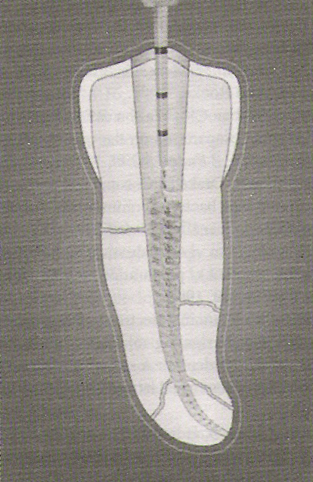
Recently microbrushes have been introduced to optimally finish the root canal preparation. They can be used in rotary or ultrasonic hand-pieces in the presence of 17% EDTA. It enhance the cleanliness of the preparation (Keir et al, 1990).

Slide 21
MTAD
A mixture of tetracycline isomer, acid and detergent (Dentsply) is a new generation combination product for root canal irrigation.
It has a low pH (2.15) because it contains citric acid, it removes smear layer after NaOCl irrigation and it has antibacterial activity against endodontic microbes.

Slide 22
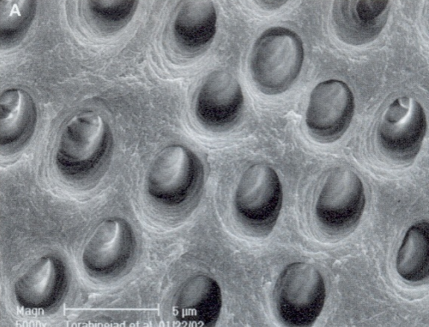
Torabinejad M have recommended the use of 1.3% NaOCl during instrumentation, followed by MTAD to remove the smear layer.
Portenier et al. showed that MTAD killed microorganisms in vitro in less than 5 minutes.

Slide 23
Torabinejad et al (2003) showed that although MTAD removes most of the smear layer when used as an intracanal irrigant, some remnants of the organic component of the smear layer remain scattered on the surface of the root canal walls. The effectiveness of MTAD to completely remove the smear layer is enhanced when low concentrations of NaOCl are used as an intracanal irrigant before the use of MTAD as a final rinse.

Slide 24
Laser
Lasers can be used to vaporize tissues in the root canal, remove the smear layer and eliminate residual tissue in the apical portion of the root canals.
Kimura et al (2002); main difficulty with the laser removal of the smear layer is access to the small canal spaces with the relatively large probes that are available.

Slide 25
The effectiveness of lasers depends on many factors:
Power level
Duration of exposure
Absorption of light in the tissues
Geometry of the root canal
Tip-to-target distance

Slide 26
TAKE HOME MESSAGE
Our knowledge of the smear layer, its structure and function is rapidly growing and will influence all areas of clinical dentistry in the near future. Much more work needs to be done, but the promise of greater understanding of the smear layer should provide increased beneficial through improved dental therapy.

Slide 27
QUESTIONS
What is smear layer?
What are different components of smear layer?
What are methods of removal of smear layer?

Slide 28
references
Abou-Rass M and Piccinino MV. The effectiveness of four clinical irrigation methods on the removal of root canal debris. Oral Surg Oral Med Oral Pathol 1982;54:323.
Czonstkowsky M et al. The smear layer in endodontics. Dent Clin North Am 1990;34:13.
Torabinejad M et al. Clinical implications of the smear layer in endodontics: a review. Oral Surg Oral Med Oral Pathol Oral Radiol Endod 2002;94:658.

Slide 29
Baumgartner JC and Mader CL. A scanning electron microscope evaluation of four root canal irrigation regimes. J Endod 1987;13;147.
Bergenholtz G and Spangberg L. Controversies in endodontics. Crit Rev Oral Biol Med 2004;15:99.
Calt S and Serper A. Time dependent effects of EDTA of dentin structures. J Endod 2002;28:17.
Cameron JA. Factors affecting the clinical efficiency of ultrasonic endodontics: a scanning electron microscopy study. Int Endod J 1995;28:47.

Slide 30
Haapasalo M and Orstavik D. In vitro infection and disinfection of dentinal tubules. J Dent Res 1987;66:1375-9.
Czonstkowsky M, Wilson EG and Holstein FA. The smear layer in endodontics. Dent Clin North Am 1990;34:13-25.
Chang SL. Modern concept of disinfection. J Sanit Eng Div Proc ASCE 1971;97-689.

Slide 31

THANKYOU

